Slide 1

Slide 1
New American vodka product launch
in Iowa
by Maks Piotrowski
30.07.2024

Slide 2
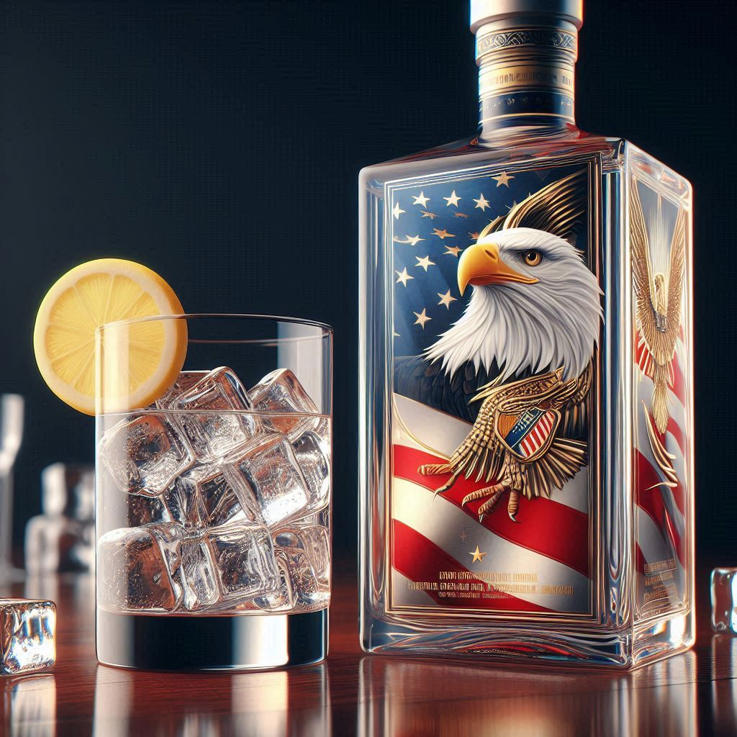

Slide 2
Business task
Objective: Identify the most effective date and store locations within specific Iowa counties for the introduction of a new American vodka.
Geographical Focus: Analyze past sales data to pinpoint high-performance liquor stores across selected counties in Iowa, ensuring the chosen locations align with potential market demand for vodka.
Promotional Strategy: Selection of stores for exclusive advertising campaigns, special promotions, and dedicated display units such as specialized shelves or coolers exclusively for this new product.
*Generated by DALL-E 3
2

Slide 3
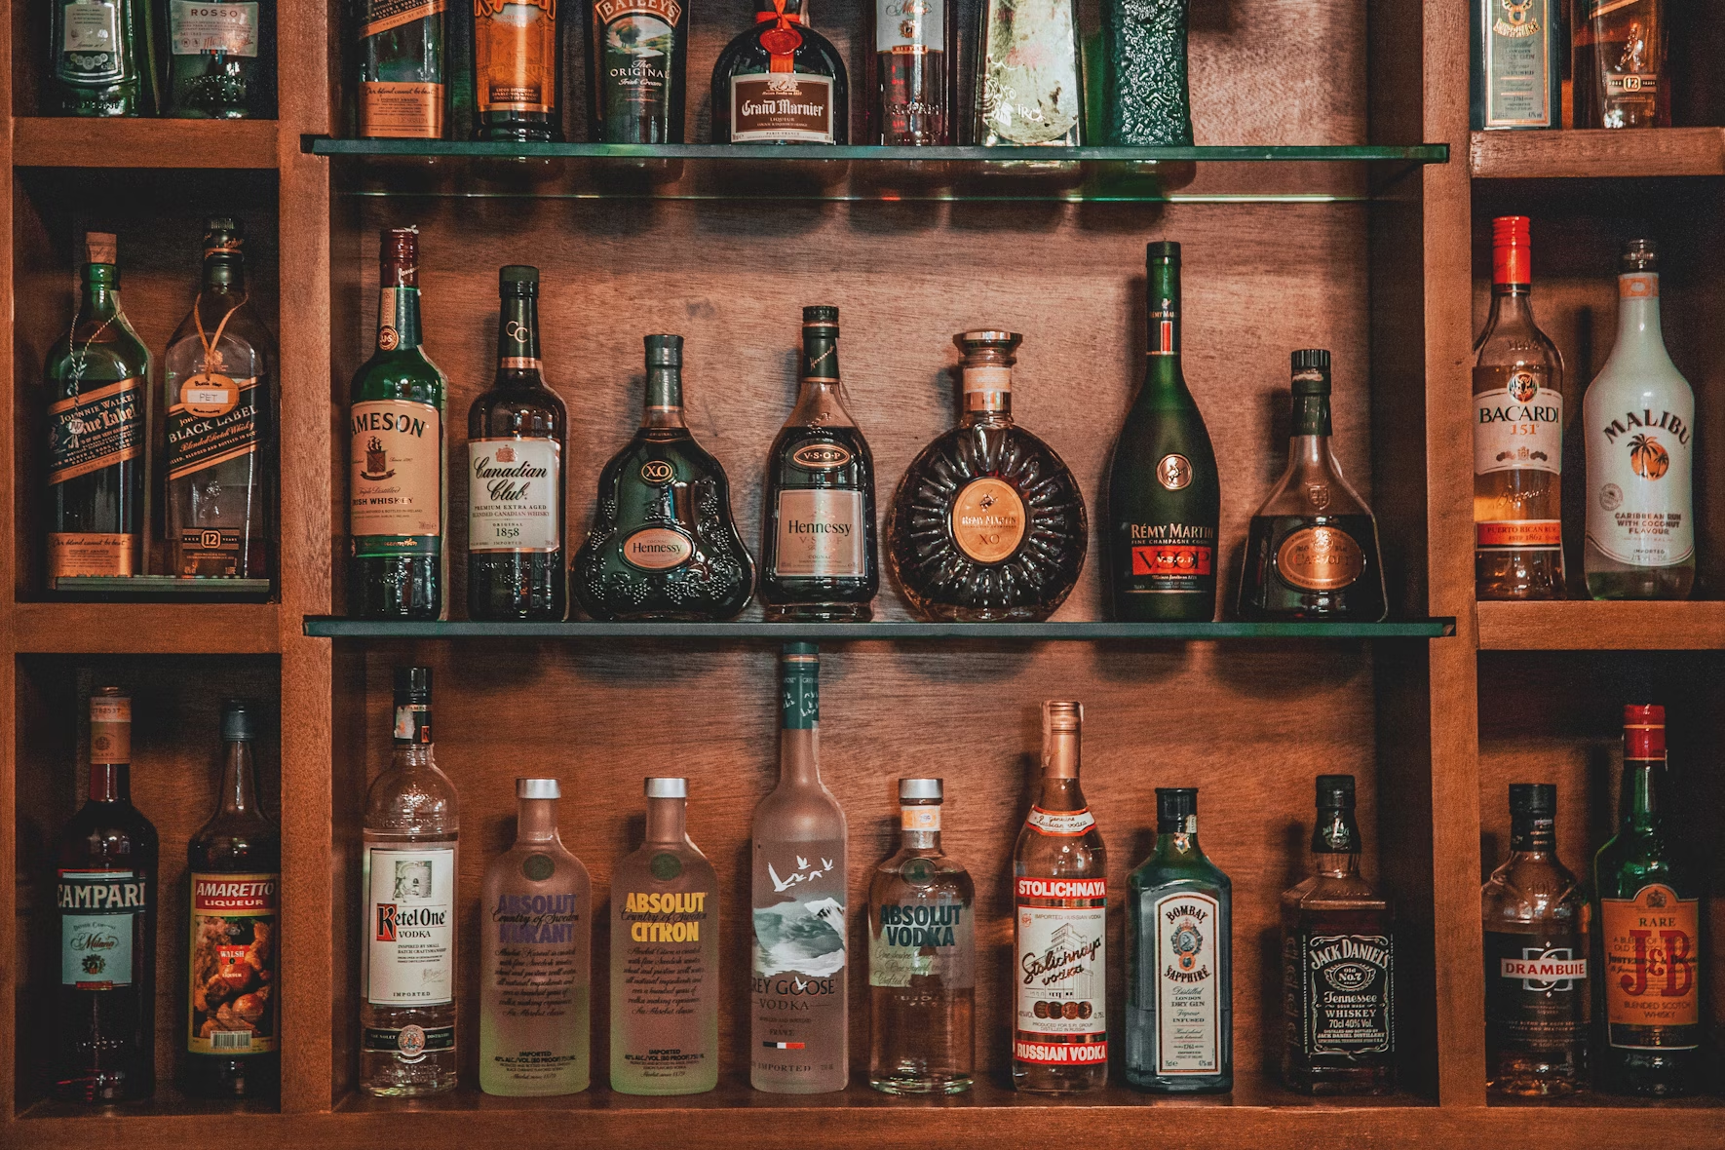
Slide 3
Dataset
e
e
Name: Iowa Liquor Sales
Provider: Alcoholic Beverages Division
Description: This dataset contains the spirits purchase information of Iowa Class “E” liquor licensees by product and date of purchase from 1.01.2012 to current. The dataset can be used to analyze total spirits sales in Iowa of individual products at the store level.
Updates: This dataset is updated monthly
Link: Iowa Liquor Sales | data.iowa.gov
Author: John Hernandez, Unsplash
3

Slide 4
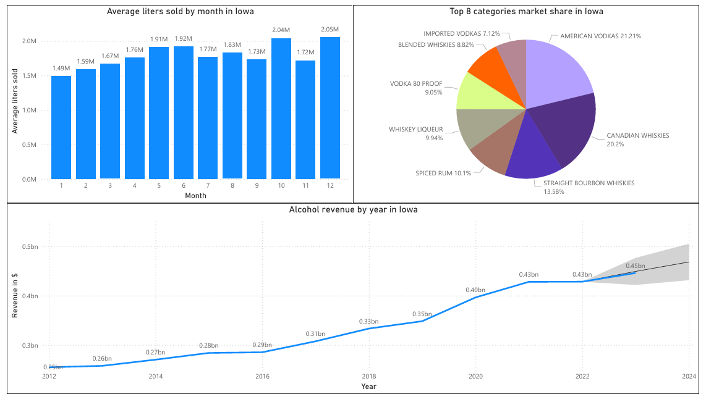
Slide 3
Exploratory Data Analysis
e
4

Slide 5

Slide 11
Strategy A

Slide 6
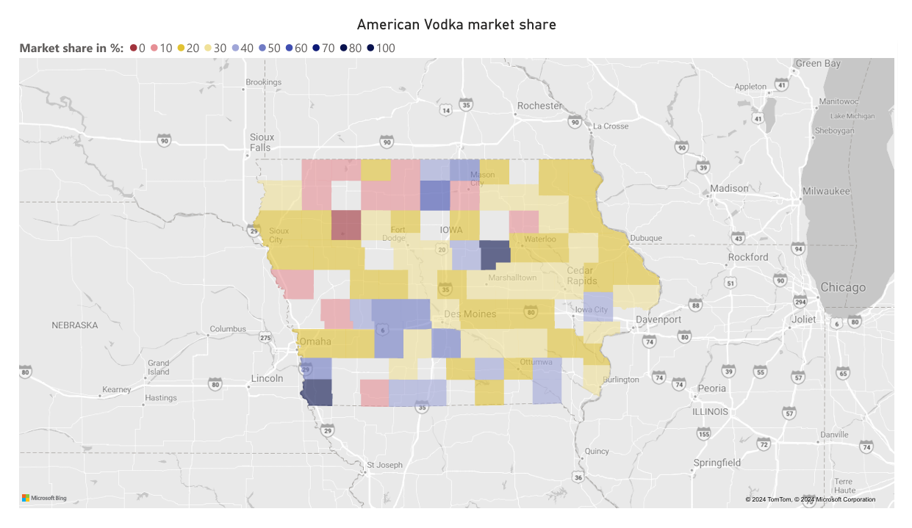
Slide 4
Strategy A
Targeting counties and stores with already strong liquor sales and a high vodka market share.
Prioritize locations with consumer interest in vodka, reducing the risk.
Focus on areas with established demand to maximize ROI for marketing expenses.
Benefit from the existing customer base familiar with and favorable towards vodka.
6

Slide 7
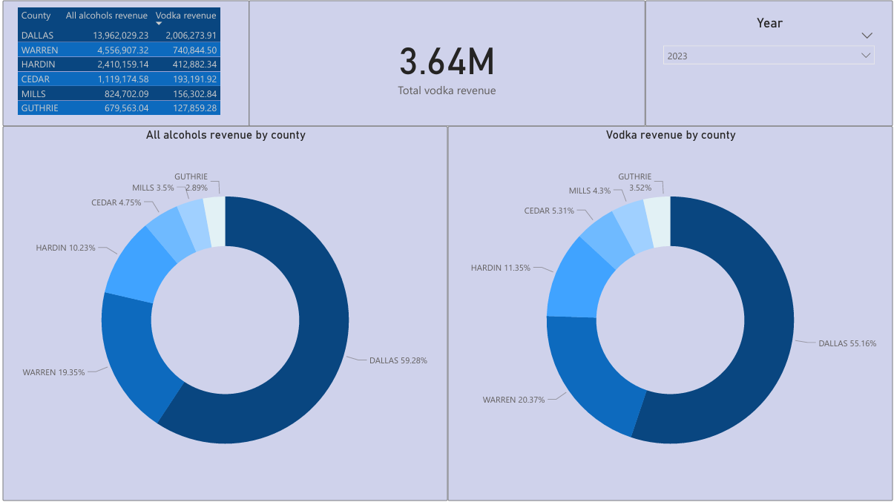
Slide 5
Target counties
Dallas
Warren
Hardin
Cedar
Guthrie
Mills
7

Slide 8
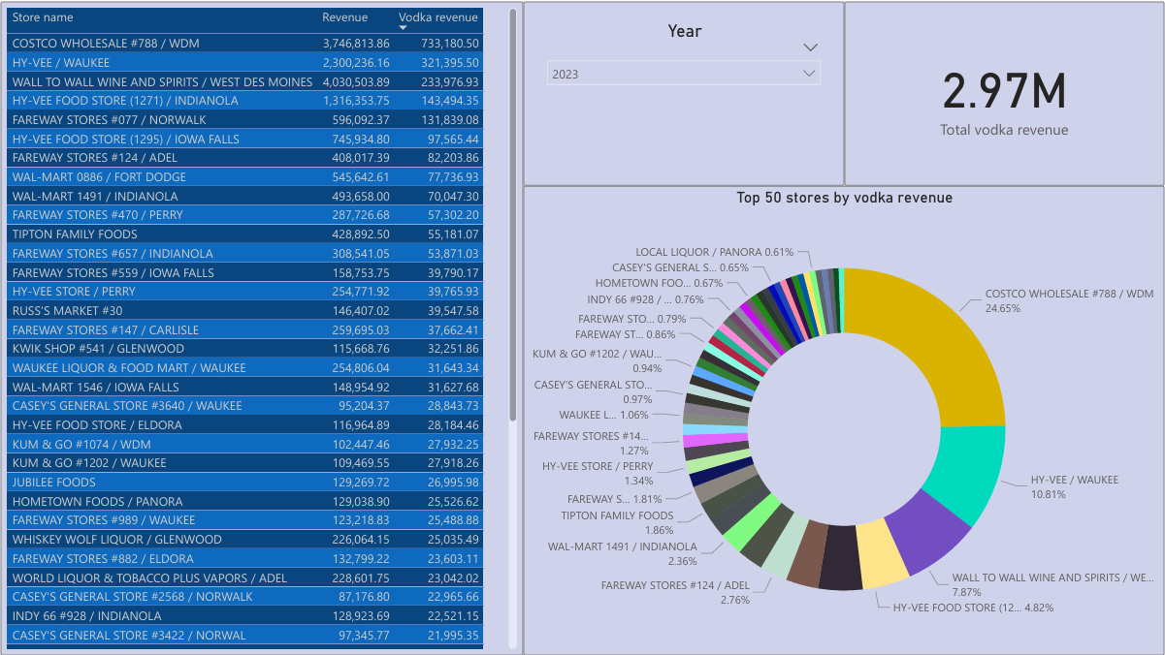
Slide 6
Target stores
e
e
Top Performers Overview: Table lists the top 50 stores based on total revenue, collectively generating $2.97 million in 2023.
Market Dominance: Some stores significantly outperform others, indicating key locations where the new vodka product could be successfully introduced.
Targeted Marketing: Use this data to tailor marketing strategies for these stores, including specialized promotions and exclusive product placements.
Investment Justification: The substantial revenue from these stores justifies investment in targeted advertising and customized display units to maximize visibility and sales of the new product.
8

Slide 9
Slide 11
Strategy B

Slide 10
Slide 4
Strategy B
Targeting counties and stores with strong liquor sales and low vodka market share
Prioritize locations with consumer interest in liquors other than vodka for high profit and high risk
Focus on areas with established high demand for liquors
Benefit from the low vodka competition with a chance to convince customers to vodka
10

Slide 11
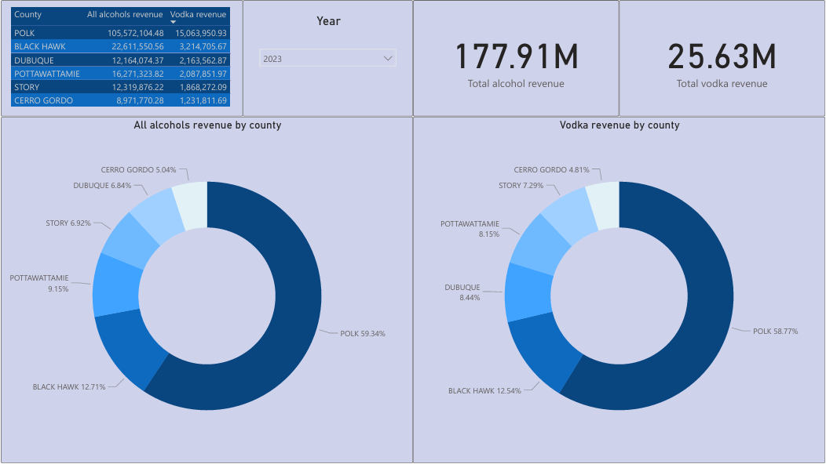
Slide 5
Target counties
Polk
Black Hawk
Dubuque
Pottawattamie
Story
Cerro Gordo
11

Slide 12
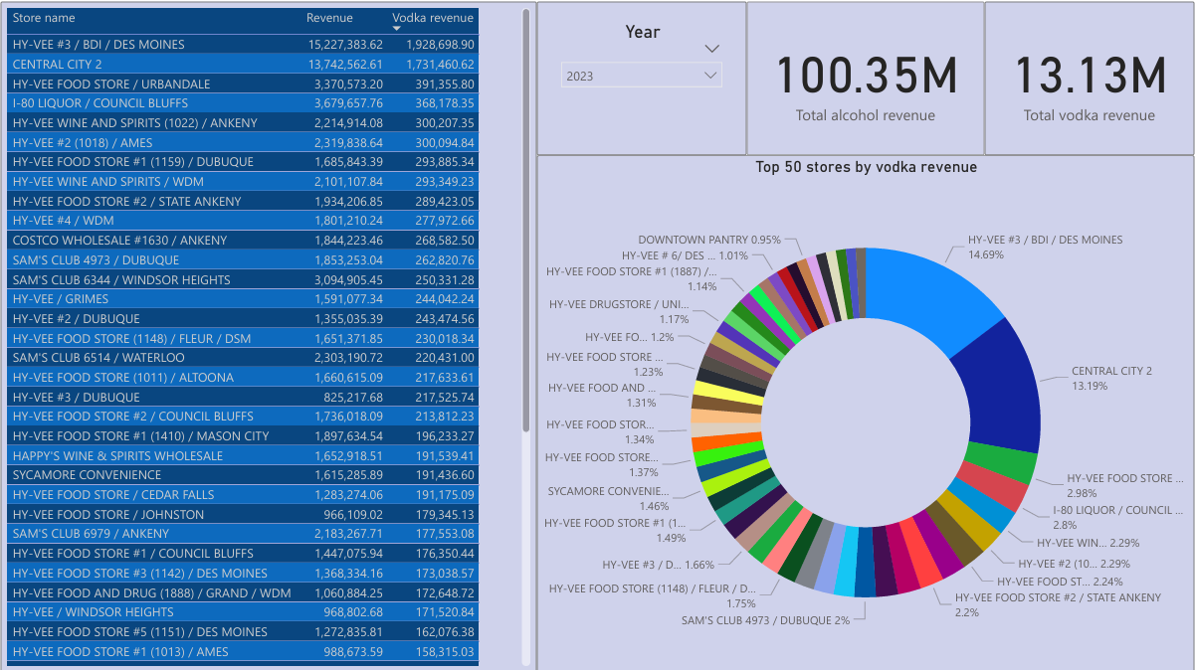
Slide 6
Target stores
e
Strategic Overview: Focus on regions where overall alcohol sales are high ($100.35 million ), but vodka sales ($13.13 million) are underrepresented relative to average alcohol market share in Iowa.
Market Potential: Highlight areas with substantial alcohol consumption but lower-than-average vodka sales, indicating potential growth opportunities for the vodka category.
Marketing Strategy: Plan targeted marketing efforts, including exclusive promotions, special pricing strategies, and enhanced in-store visibility, to increase vodka's appeal to consumers in selected stores.
Strategic Goals: The aim is to elevate vodka's profile in markets where it has room to grow, leveraging high general alcohol sales as a springboard for increasing vodka's market share.
12

Slide 13
Slide 11
Marketing
timeframe

Slide 14
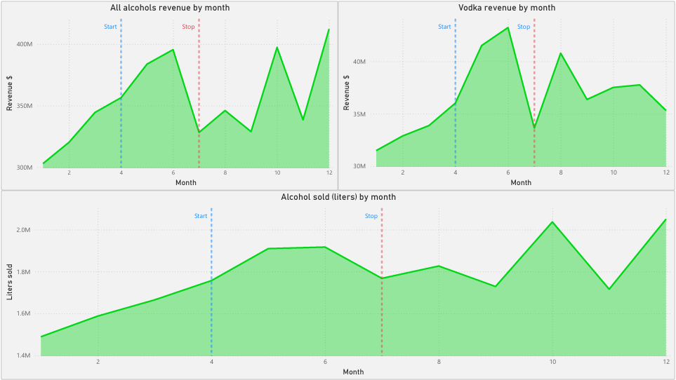
Slide 8
Marketing timeframe
Selected Timeframe: Marketing campaign to run from April to July, aligning with peak sales periods for vodka, identified through historical sales data.
e
Seasonal Advantage: The chosen months coincide with the summer vacation season, a time when consumer alcohol consumption typically increases due to social gatherings and holiday celebrations.
Sentimental Purchasing: Capitalize on positive summer experiences associated with relaxation and enjoyment, which can influence consumers to make nostalgic purchases even later in the year.
Long-Term Engagement: Initiatives launched in these months can create lasting impressions, encouraging repeat purchases and establishing brand loyalty among new customers.
14

Slide 15
Slide 11
THANK YOU
THE END

